Slide 1
Electron Transport Chain
Sonali Saha
Microbiology

Slide 2
Mitochondria make ATP through cellular respiration
Mitochondria usually give rise to other mitochondria by growth and subsequent division. Each mitochondrion is enclosed by a double membrane, which forms two different compartments within the organelle: the intermembrane space and the matrix.
The intermembrane space is the compartment formed between the outer and inner mitochondrial membranes. The matrix, the compartment enclosed by the inner mitochondrial membrane, contains enzymes that break down food molecules and convert their energy to other forms of chemical energy.
The outer mitochondrial membrane is smooth and allows many small molecules to pass through it. By contrast, the inner mitochondrial membrane has numerous folds and strictly regulates the types of molecules that can move across it.
The folds, called cristae (sing.,crista), extend into the matrix. Cristae greatly increase the surface area of the inner mitochondrial membrane, providing a surface for the chemical reactions that transform the chemical energy in food molecules into the energy of ATP.
The membrane contains the enzymes and other proteins needed for these reactions.
Mitochondria affect health and aging by leaking electrons. These electrons form free radicals, which are toxic, highly reactive compounds with unpaired electrons. The electrons bond with other compounds in the cell, interfering with normal function .

Slide 3
Mitochondria play an important role in programmed cell death, or apoptosis. Unlike necrosis, which is uncontrolled cell death that causes infl ammation and damages other cells, apoptosis is a normal part of development and maintenance. For example, during the metamorphosis of a tadpole to a frog, the cells of the tadpole tail must die. The hand of a human embryo is webbed until apoptosis destroys the tissue between the fi ngers. Cell death also occurs in the adult. For example, cells in the upper layer of human skin and in the intestinal wall are continuously destroyed and replaced by new cells. Mitochondria initiate cell death in several different ways. For example, they can interfere with energy metabolism or activate enzymes that mediate cell destruction.
When a mitochondrion is injured, large pores open in its membrane, and cytochrome c, a protein important in energy production, is released into the cytoplasm. Cytochrome c triggers apoptosis by activating enzymes known as caspases, which cut up vital compounds in the cell. Inappropriate inhibition of apoptosis may contribute to a variety of diseases, including cancer.

Slide 4
Too much apoptosis may deplete needed cells and lead to acquired immunodeficiency syndrome (AIDS). Pharmaceutical companies are developing drugs that block apoptosis. However, cell dynamics are extremely complex, and blocking apoptosis could lead to a worse fate, including necrosis .
Each mitochondrion in a mammalian cell has 5 to 10 identical, circular molecules of DNA, accounting for up to 1% of the total DNA in the cell.
Mitochondrial DNA mutates far more frequently than nuclear DNA.
Mutations in mitochondrial DNA have been associated with certain genetic diseases, including a form of young adult blindness, and certain types of progressive muscle degeneration.
Mutations that promote apoptosis may be an important mechanism in mammalian aging.

Slide 5
Mitochondria Are the Principal Sites of ATP Production in Aerobic Cells
Most eukaryotic cells contain many mitochondria, which occupy up to 25 percent of the volume of the cytoplasm. These complex organelles, the main sites of ATP production during aerobic metabolism, are generally exceeded in size only by the nucleus, vacuoles, and chloroplasts. The two membranes that bound a mitochondrion differ in composition and function.
The outer membrane, composed of about half lipid and half protein, contains porins that render the membrane permeable to molecules having molecular weights as high as 10,000. In this respect, the outer membrane is similar to the outer membrane of gram-negative bacteria.
The inner membrane, which is much less permeable, is about 20 percent lipid and 80 percent protein—a higher proportion of protein than exists in other cellular membranes. The surface area of the inner membrane is greatly increased by a large number of infoldings, or cristae, that protrude into the matrix, or central space.

Slide 6
In nonphotosynthetic cells, the principal fuels for ATP synthesis are fatty acids and glucose. The complete aerobic degradation of glucose to CO2 and H2O is coupled to the synthesis of as many as 30 molecules of ATP.
In eukaryotic cells, the initial stages of glucose degradation take place in the cytosol, where 2 ATP molecules per glucose molecule are generated.
The terminal stages of oxidation and the coupled synthesis of ATP are carried out by enzymes in the mitochondrial matrix and inner membrane. As many as 28 ATP molecules per glucose molecule are generated in mitochondria.
Similarly, virtually all the ATP formed in the oxidation of fatty acids to CO2 is generated in mitochondria. Thus mitochondria can be regarded as the “power plants” of the cell.

Slide 7
The electron transport chain is coupled to ATP synthesis
Let us consider the fate of all the electrons removed from a molecule of glucose during glycolysis, acetyl CoA formation, and the citric acid cycle. Recall that these electrons were transferred as part of hydrogen atoms to the acceptors NAD and FAD, forming NADH and FADH2. These reduced compounds now enter the electron transport chain, where the high-energy electrons of their hydrogen atoms are shuttled from one acceptor to another. As the electrons are passed along in a series of exergonic redox reactions, some of their energy is used to drive the synthesis of ATP, which is an endergonic process. Because ATP synthesis (by phosphorylation of ADP) is coupled to the redox reactions in the electron transport chain, the entire process is known as oxidative phosphorylation.

Slide 8
The electron transport chain transfers electrons from NADH and FADH2 to oxygen
The electron transport chain is a series of electron carriers embedded in the inner mitochondrial membrane of eukaryotes and in the plasma membrane of aerobic prokaryotes. Like NADH and FADH2, each carrier exists in an oxidized form or a reduced form. Electrons pass down the electron transport chain in a series of redox reactions that works much like a bucket brigade.
In the electron transport chain, each acceptor molecule becomes alternately reduced as it accepts electrons and oxidized as it gives them up.
The electrons entering the electron transport chain have a relatively high energy content. They lose some of their energy at each step as they pass along the chain of electron carriers (just as some of the water spills out of the bucket as it is passed from one person to another).

Slide 9
Members of the electron transport chain include the flavoprotein flavin mononucleotide (FMN), the lipid ubiquinone (also called coenzyme Q or CoQ), several iron–sulfur proteins, and a group of closely related iron containing proteins called cytochromes (Fig. 8-8).
Each electron carrier has a different mechanism for accepting and passing electrons. As cytochromes accept and donate electrons, for example, the charge on the iron atom, which is the electron carrier portion of the cytochromes, alternates between Fe ²⁺ (reduced) and Fe ³⁺ (oxidized).
Because oxygen is the final electron acceptor in the electron transport chain, organisms that respire aerobically require oxygen.

Slide 10
What happens when cells that are strict aerobes are deprived of oxygen? The last cytochrome in the chain retains its electrons when no oxygen is available to accept them. When that occurs, each acceptor molecule in the chain retains its electrons (each remains in its reduced state), and the entire chain is blocked all the way back to NADH. Because oxidative phosphorylation is coupled to electron transport, no additional ATP is produced by way of the electron transport chain. Most cells of multicellular organisms cannot live long without oxygen, because the small amount of ATP they produce by glycolysis alone is insufficient to sustain life processes.
Lack of oxygen is not the only factor that interferes with the electron transport chain. Some poisons, including cyanide, inhibit the normal activity of the cytochromes. Cyanide binds tightly to the iron in the last cytochrome in the electron transport chain (cytochrome a3), making it unable to transport electrons to oxygen. This blocks the further passage of electrons through the chain, and ATP production ceases. Although the fl ow of electrons in electron transport is usually tightly coupled to the production of ATP, some organisms uncouple the two processes to produce heat.

Slide 11
Scientists have extracted and purified the electron transport chain from the inner mitochondrial membrane as four large, distinct protein complexes, or groups, of acceptors.
Complex I (NADH–ubiquinone oxidoreductase) accepts electrons from NADH molecules that were produced during glycolysis, the formation of acetyl CoA, and the citric acid cycle.
Complex II (succinate–ubiquinone reductase) accepts electrons from FADH2 molecules that were produced during the citric acid cycle.
Complexes I and II both produce the same product, reduced ubiquinone, which is the substrate of complex III (ubiquinone– cytochrome c oxidoreductase). That is, complex III accepts electrons from reduced ubiquinone and passes them on to cytochrome c.
Complex IV (cytochrome c oxidase) accepts electrons from cytochrome c and uses these electrons to reduce molecular oxygen, forming water in the process. The electrons simultaneously unite with protons from the surrounding medium to form hydrogen, and the chemical reaction between hydrogen and oxygen produces water.

Slide 12
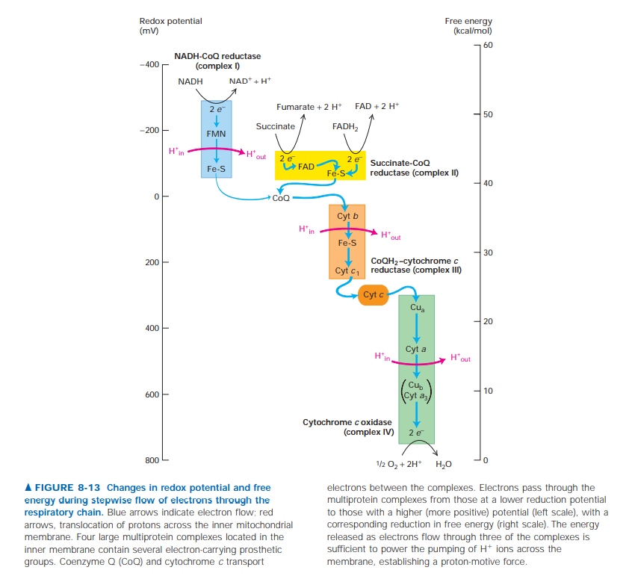

Slide 13
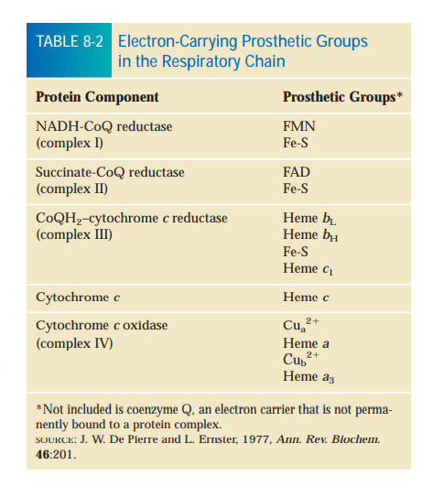
Electrons Flow from FADH2 and NADH to O2 Through a Series of Four
Multiprotein Complexes
In respiring mitochondria, each NADH molecule releases two electrons to the respiratory chain; these electrons ultimately reduce one oxygen atom
(half of an O2 molecule), forming one molecule of water:
NADH NAD⁺ + H⁺+ 2 e⁻
2 e⁻ + 2 H⁺ + 1⁄2 O₂ H₂O
As electrons move from NADH to O2, their potential declines by 1.14 V, which corresponds to 26.2 kcal/mol of electrons transferred, or ≈ 53 kcal/mol for a pair of electrons.
Much of this energy is conserved in the proton-motive force generated across the inner mitochondrial membrane. Each of the four large multiprotein complexes in the respiratory chain spans the inner mitochondrial membrane and contains several prosthetic groups that participate in moving electrons. These small nonpeptide organic molecules or metal ions are tightly and specifically associated with the multiprotein complexes (Table 8-2). Several types of heme, an iron-containing prosthetic group similar to that in hemoglobin and myoglobin, are tightly bound or covalently linked to mitochondrial proteins, forming the cytochromes. Electron flow through the cytochromes occurs by oxidation and reduction of the Fe atom in the center of the heme molecule: Fe ³⁺ + e⁻ Fe²⁺

Slide 14
In the respiratory chain, electrons move through the cytochromes in the following order: b, c1, c, a, and a3 (see Figure 8-13). The various cytochromes have slightly different heme groups and axial ligands, which generate different environments for the Fe ion. Therefore, each cytochrome has a different reduction potential, or tendency to accept an electron—an important property dictating the unidirectional electron flow along the chain. Because the heme ring in cytochromes consists of alternating double and single-bonded atoms, a large number of resonance forms exist, and the extra electron is delocalized to the heme carbon and nitrogen atoms as well as to the Fe ion. All the cytochromes, except cytochrome c, are components of multiprotein complexes in the inner mitochondrial membrane. Although cytochrome c comprises a hemeprotein complex, it moves freely by diffusion in the intermembrane space.

Slide 15
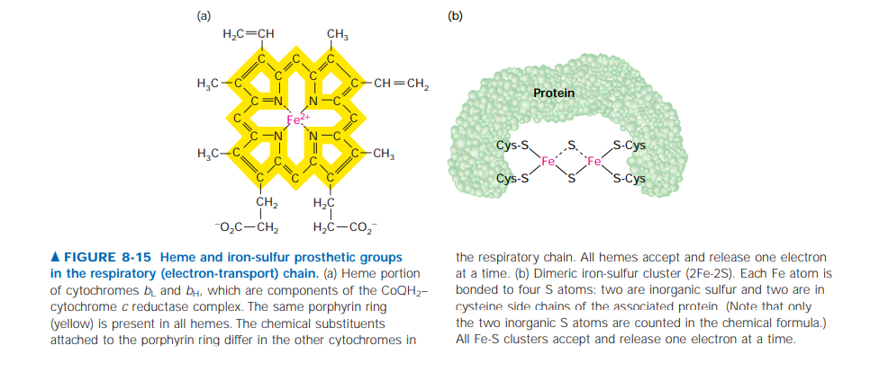
Iron-sulfur clusters are nonheme, iron-containing prosthetic groups consisting of Fe atoms bonded both to inorganic S atoms and to S atoms on cysteine residues on a protein. Some Fe atoms in the cluster bear a 2 charge; others have a 3 charge. However, the net charge of each Fe atom is actually between 2 and 3 because electrons in the outermost orbits are dispersed among the Fe atoms and move rapidly from one atom to another. Iron-sulfur clusters accept and release electrons one at a time; the additional electron is also dispersed over all the Fe atoms in the cluster.

Slide 16
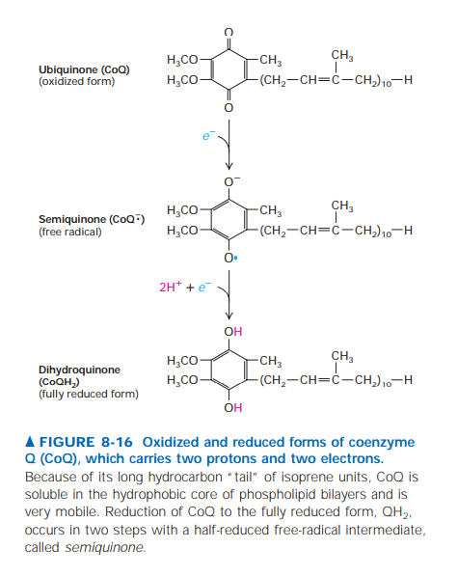
Coenzyme Q (CoQ), also called ubiquinone, is the only electron carrier in the respiratory chain that is not a protein bound prosthetic group. It is a carrier of hydrogen atoms, that is, protons plus electrons. The oxidized quinone form of CoQ can accept a single electron to form a semiquinone, a charged free radical denoted by CoQ⁻·. Addition of a second electron and two protons to CoQ⁻· forms dihydroubiquinone (CoQH2), the fully reduced form. Both CoQ and CoQH2 are soluble in phospholipids and diffuse freely in the inner mitochondrial membrane.

Slide 17
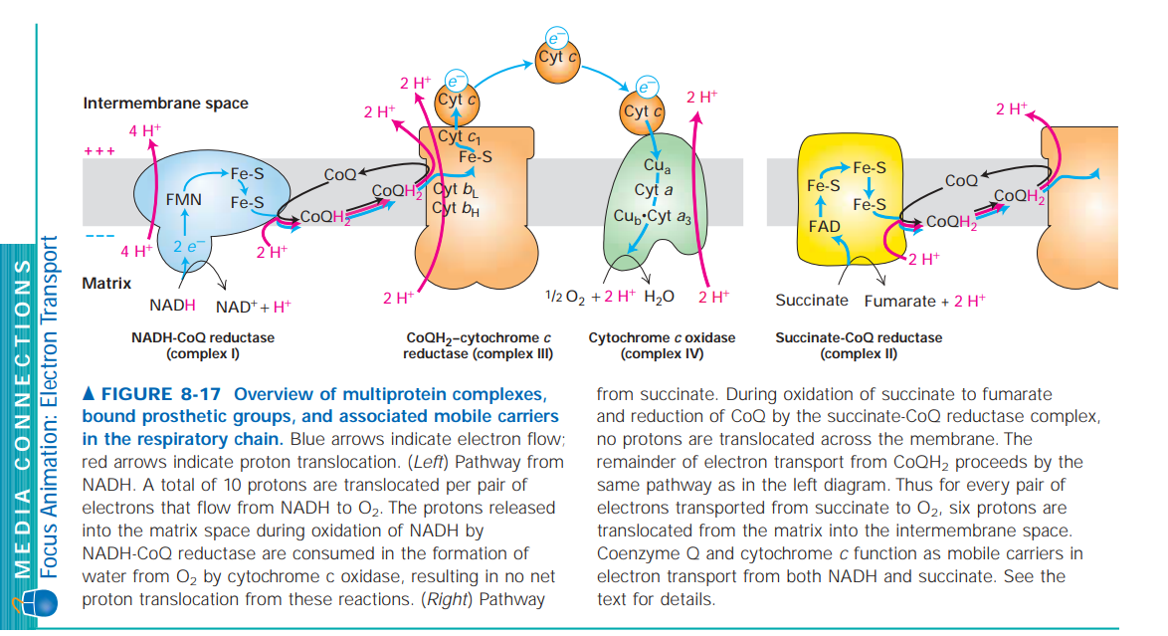

Slide 18
CoQ accepts electrons released from the NADH-CoQ reductase complex (I) and the succinate-CoQ reductase complex (II) and donates them to the CoQH2–cytochrome c reductase complex (III).
Reduction and oxidation of CoQ are coupled to pumping of protons.
Whenever CoQ accepts electrons, it does so at a binding site on the cytosolic (matrix) face of the protein complex, always picking up protons from the medium facing the cytosolic face.
Whenever CoQH2 releases its electrons, it does so at a binding site on the exoplasmic face of the protein complex, releasing protons into the exoplasmic medium (intermembrane space). Thus transport of each pair of electrons by CoQ is obligatorily coupled to movement of two protons from the cytosolic to the exoplasmic medium.

Slide 19
NADH-CoQ Reductase (Complex I) Electrons are carried from NADH to CoQ by the NADH-CoQ reductase complex. NAD is exclusively a two-electron carrier: it accepts or releases a pair of electrons at a time.
In the NADH-CoQ reductase complex, electrons first flow from NADH to FMN (flavin mononucleotide), a cofactor related to FAD, then to an iron-sulfur cluster, and finally to CoQ. FMN, like FAD, can accept two electrons, but does so one electron at a time.
The overall reaction catalyzed by this complex is :
NADH + CoQ + 2 H⁺ NAD ⁺ + H ⁺ + CoQH2
(Reduced) (Oxidized) (Oxidized) (Reduced)
Each transported electron undergoes a drop in potential of ≈360 mV, equivalent to a G ^{°ˊ} of -16.6 kcal/mol for the two electrons transported. Much of this released energy is used to transport four protons across the inner membrane per molecule of NADH oxidized by the NADH-CoQ reductase complex.

Slide 20
Succinate-CoQ Reductase (Complex II)
Succinate dehydrogenase, the enzyme that oxidizes a molecule of succinate to fumarate in the citric acid cycle, is an integral component of the succinate-CoQ reductase complex. The two electrons released in conversion of succinate to fumarate are transferred first to FAD, then to an iron-sulfur cluster, and finally to Co). The overall reaction catalyzed by this complex is
Succinate + CoQ fumarate + CoQH2
(Reduced) (Oxidized) (Oxidized) (Reduced)
Although the G ^{°ˊ} for this reaction is negative, the released energy is insufficient for proton pumping. Thus no protons are translocated across the membrane by the succinate-CoQ reductase complex, and no proton-motive force is generated in this part of the respiratory chain.

Slide 21
CoQH2–Cytochrome c Reductase (Complex III)
A CoQH2 generated either by complex I or complex II donates two electrons to the CoQH2–cytochrome c reductase complex, regenerating oxidized CoQ. Concomitantly it releases two protons picked up on the cytosolic face into the intermembrane space, generating part of the proton-motive force. Within complex III, the released electrons first are transferred to an iron-sulfur cluster within complex III and then to two b-type cytochromes (bL and bH) or cytochrome c1. Finally, the two electrons are transferred to two molecules of the oxidized form of cytochrome c, a water-soluble peripheral protein that diffuses in the intermembrane space. For each pair of electrons transferred, the overall reaction catalyzed by the CoQH2–cytochrome c reductase complex is :
CoQH2 + 2 Cyt c³⁺ CoQ + 2 H ⁺ + 2 Cyt c²⁺
(Reduced) (Oxidized) (Oxidized) (Reduced)
The G ^{°ˊ} for this reaction is sufficiently negative that two additional protons are translocated from the mitochondrial matrix across the inner membrane for each pair of electrons transferred; this involves the proton-motive Q cycle.

Slide 22
Cytochrome c Oxidase (Complex IV)
Cytochrome c, after being reduced by the CoQH2–cytochrome c reductase complex, transports electrons, one at a time, to the cytochrome c oxidase complex. Within this complex, electrons are transferred, again one at a time, first to a pair of copper ions called Cua ²⁺, then to cytochrome a, next to a complex of another copper ion (Cub ²⁺) and cytochrome a3, and finally to O2, the ultimate electron acceptor, yielding H2O. For each pair of electrons transferred, the overall reaction catalyzed by the cytochrome c oxidase complex is:
2 Cyt c²⁺+ 2 H⁺ + 1⁄2 O2 2 Cyt c³⁺ + H2O
(Reduced) (Oxidized)
During transport of each pair of electrons through the cytochrome c oxidase complex, two protons are translocated across the membrane.

Slide 23
CoQ and Cytochrome c as Mobile Electron Shuttles The four electron-transport complexes just described are laterally mobile in the inner mitochondrial membrane; moreover, they are present in unequal amounts and do not form stable contacts with one another. These properties preclude the direct transfer of electrons from one complex to the next. Instead, electrons are transported from one complex to another by diffusion of CoQ in the membrane and by cytochrome c in the intermembrane space.

Slide 24
The chemiosmotic model explains the coupling of ATP synthesis to electron transport in aerobic respiration
For decades, scientists were aware that oxidative phosphorylation occurs in mitochondria, and many In 1961, Peter Mitchell, proposed the chemiosmotic model, which was based on his experiments with bacteria. Because the respiratory electron transport chain is located in the plasma membrane of an aerobic bacterial cell, the bacterial plasma membrane can be considered comparable to the inner mitochondrial membrane. Mitchell demonstrated that if bacterial cells are placed in an acidic environment (that is, an environment with a high hydrogen ion, or proton, concentration), the cells synthesized ATP even if electron transport was not taking place. On the basis of these and other experiments, Mitchell proposed that electron transport and ATP synthesis are coupled by means of a proton gradient across the inner mitochondrial membrane in eukaryotes (or across the plasma membrane in bacteria). His model was so radical that it was not immediately accepted, but by 1978, so much evidence had accumulated in sup port of chemiosmosis that Peter Mitchell was awarded a Nobel Prize in Chemistry.

Slide 25
The electron transport chain establishes the proton gradient; some of the energy released as electrons pass down the electron transport chain is used to move protons (H) across a membrane. In eukaryotes the protons are moved across the inner mito chondrial membrane into the intermembrane space (Fig. 8-9). Hence, the inner mitochondrial membrane separates a space with a higher concentration of protons (the intermembrane space) from a space with a lower concentration of protons (the mitochondrial matrix). Protons are moved across the inner mitochondrial membrane by three of the four electron transport complexes (complexes I, III, and IV) (Fig. 8-10a).

Slide 26
Like water behind a dam, the resulting proton gradient is a form of potential energy that can be harnessed to provide the energy for ATP synthesis. Diffusion of protons from the intermembrane space, where they are highly concentrated, through the inner mitochondrial membrane to the matrix of the mitochondrion is limited to specific channels formed by a fifth enzyme complex, ATP synthase, a transmembrane protein. Portions of these complexes project from the inner surface of the membrane (the surface that faces the matrix) and are visible by electron microscopy (Fig. 8-10b). Diffusion of the protons down their gradient, through the ATP synthase complex, is exergonic because the entropy of the system increases. This exergonic process provides the energy for ATP production, although the exact mechanism by which ATP synthase catalyzes the phosphorylation of ADP is still not completely understood.

Slide 27
In 1997, Paul Boyer of the University of California at Los Angeles and John Walker of the Medical Research Council Laboratory of Molecular Biology, Cambridge, England, shared the Nobel Prize in Chemistry for the discovery that ATP synthase functions in an unusual way. Experimental evidence strongly suggests that ATP synthase acts like a highly efficient molecular motor: During the production of ATP from ADP and inorganic phosphate, a central structure of ATP synthase rotates, possibly in response to the force of protons moving through the enzyme complex. The rotation apparently alters the conformation of the catalytic subunits in a way that allows ATP synthesis. Chemiosmosis is a fundamental mechanism of energy coupling in cells; it allows exergonic redox reactions to drive the endergonic reaction in which ATP is produced by phosphorylating ADP. In photosynthesis, ATP is produced by a comparable process.

Slide 28
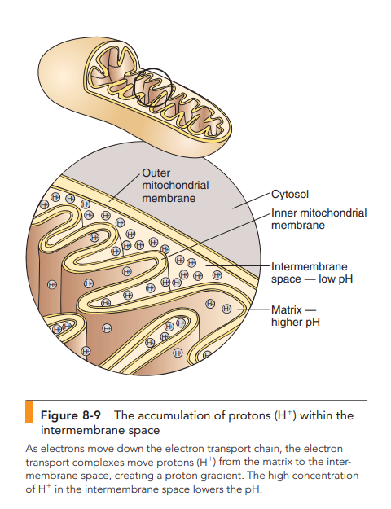
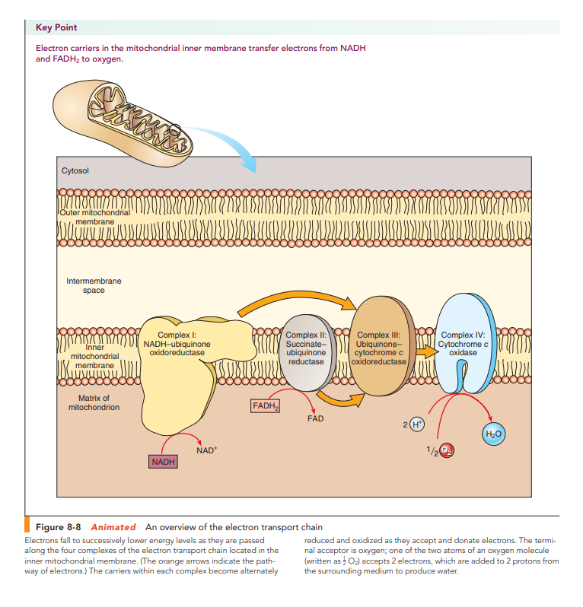

Slide 29
