Slide 1
The Human Digestive System

Slide 2
Digestion
Phases Include
  Ingestion
  Movement
  Mechanical and Chemical Digestion
  Absorption
  Elimination

Slide 3
Digestion
Types
  Mechanical (physical)
    Chew
    Tear
    Grind
    Mash
    Mix
  Chemical
    Enzymatic reactions to improve digestion of
      Carbohydrates
      Proteins
      Lipids

Slide 4
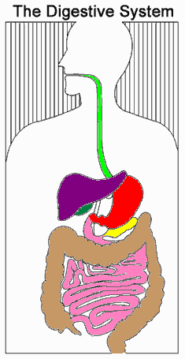
Digestive System Organization
Gastrointestinal (Gl) tract
  Tube within a tube
  Direct link/path between organs
  Structures
    Mouth
    Pharynx
    Esophagus
    Stomach
    Small intestine (duodenum, jejunum, ileum)
    Large Intestine (Ascending, Transverse and Descending colon)
    Rectum

Slide 5
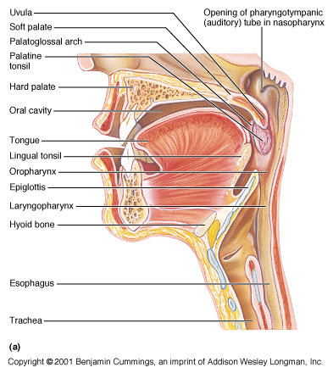
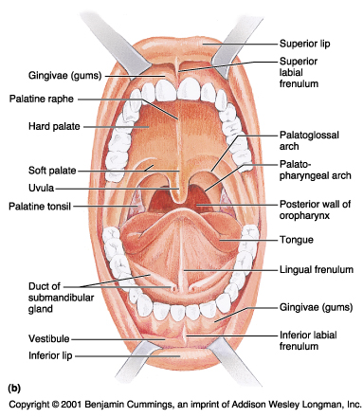
Mouth
Epiglottis is a flap-like structure at the back of the throat that closes over the trachea preventing food from entering it. It is located in the Pharynx.
Teeth mechanically break down food into small pieces. Tongue mixes food with saliva (contains amylase, which helps break down starch).

Slide 6
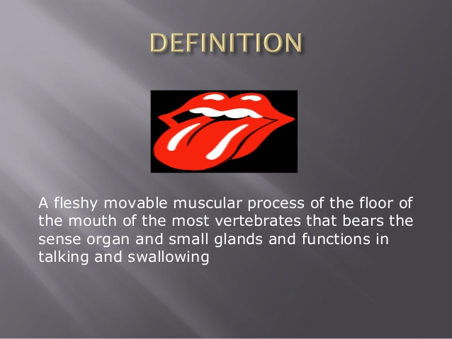
STRUCTURE OF TONGUE

Slide 7
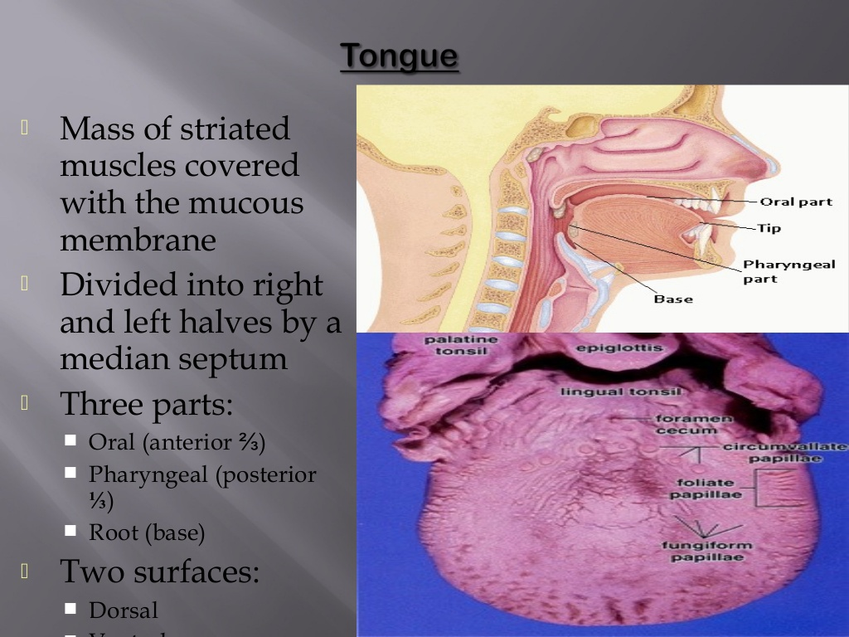

Slide 8
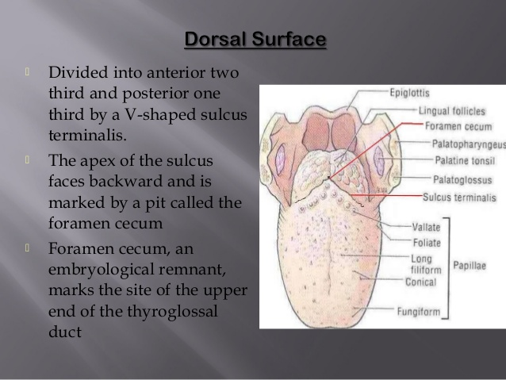

Slide 9
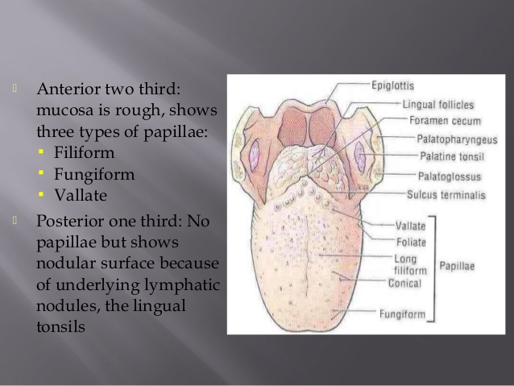

Slide 10
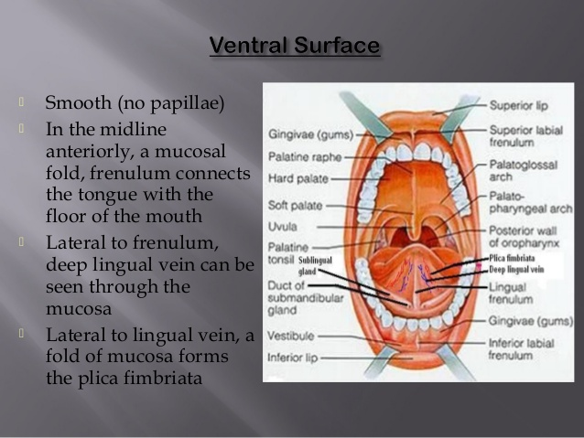

Slide 11
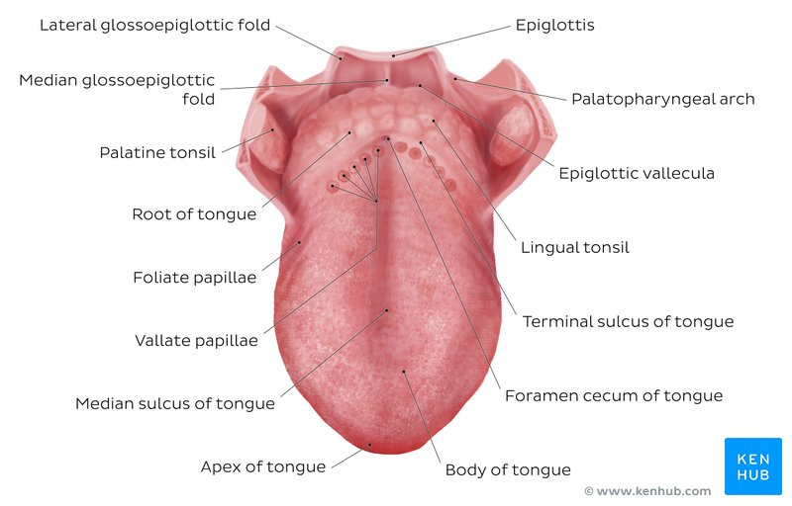
Anatomy
The tongue is a pink, muscular organ located within the oral cavity proper.
It is kept moist by the products of the major and minor salivary glands
It has three main parts:
The tip or apex of the tongue is the most anterior, and most mobile aspect of the organ.
The body of the tongue has a rough dorsal (superior) surface that abuts the palate and is populated with taste buds and lingual papillae, and a smooth ventral (inferior) surface that is attached to the floor of the oral cavity by the lingual frenulum.
The base of the tongue is the most posterior part of the organ. It is populated by numerous lymphoid aggregates known as the lingual tonsils along with foliate papillae along the posterolateral surface.

Slide 12
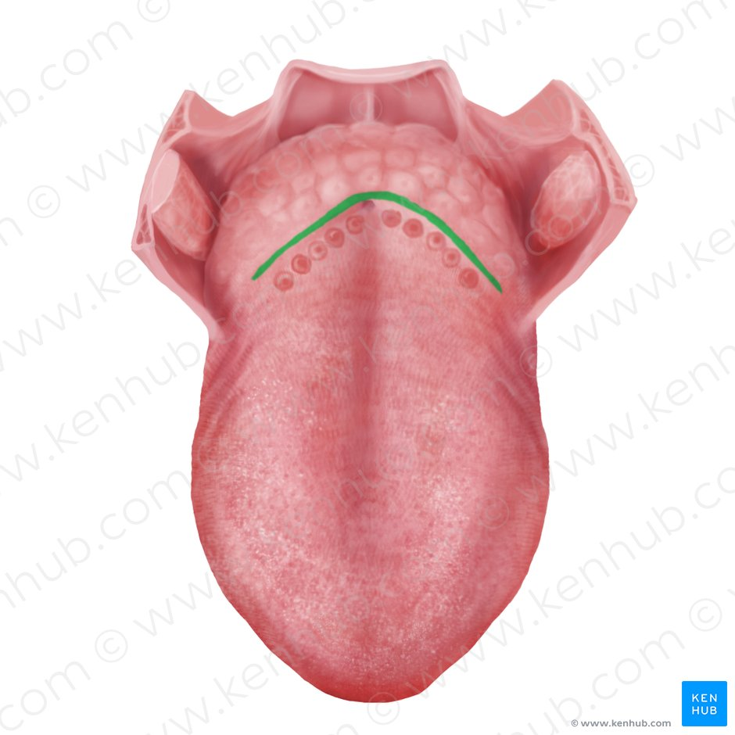
Anterior two thirds
The presulcal tongue includes the apex and body of the organ. It terminates at the sulcus terminalis; which can be seen extending laterally in an oblique direction from the foramen cecum towards the palatoglossal arch. The mucosa of the dorsal surface of the oral tongue is made up of circumvallate, filiform, and fungiform papillae. There is also a longitudinal midline groove running in an anteroposterior direction from the tip of the tongue to the foramen cecum. This marks the embryological point of fusion of the lateral lingual swellings that formed the oral tongue. It also represents the location of the median lingual (fibrous) septum of the tongue that inserts in the body of the hyoid bone.

Slide 13
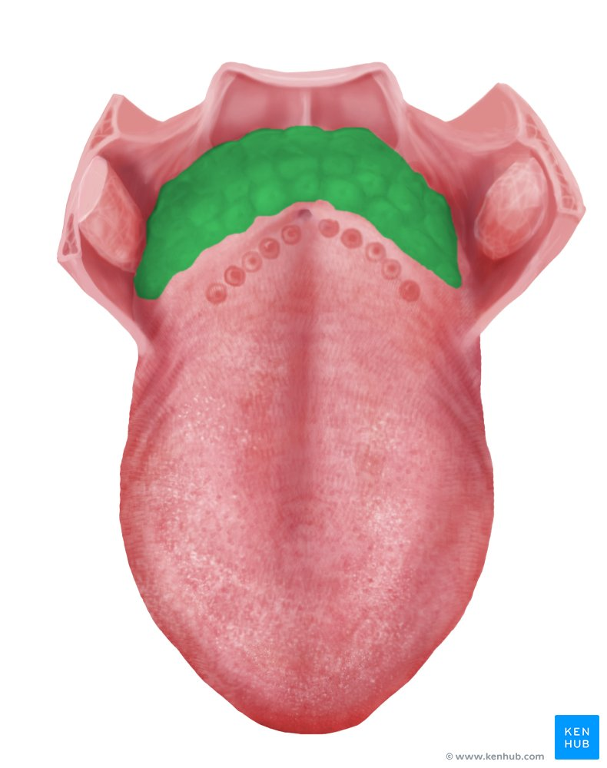
POSTERIOR THIRD
The remainder of the tongue that lies posterior to the sulcus terminalis is made up by the base of the organ. It lies behind the palatoglossal folds and functions as the anterior wall of the oropharynx. Unlike the oral tongue, the pharyngeal tongue does not have any lingual papillae. Instead, its mucosa is populated by aggregates of lymphatic tissue known as the lingual tonsils. The mucosa is also continuous with the mucosa of the laterally located palatine tonsils, the lateral oropharyngeal walls, and the posterior epiglottis and glossoepiglottic folds.

Slide 14
HISTOLOGY
The lingual mucosa is covered by stratified squamous epithelium with varying degrees of keratinization. Since the dorsal surface of the oral tongue is more at risk for desiccation and abrasions from contact with food boluses of varying temperatures and textures, it is covered by epithelium that is keratinized.
the ventral surface of the tongue as well as the pharyngeal part, are relatively well protected from the harsh environment. Therefore, the epithelia in these areas are non-keratinized.
The epithelium is adherent to the underlying striated muscle fibers of the tongue. There is a fibrous raphe in the midline of the tongue that marks the point of fusion of the embryonic lateral lingual swellings. Posteriorly, there is a variable amount of adipose tissue within the pharyngeal tongue.

Slide 15
The dorsal mucosa of the oral tongue is characterized by numerous raised structures known as lingual papillae.
Filiform papillae are the most abundant and are stretched, conical, grey-white papillae covered in a heavy coat of keratinized squamous epithelium. By making the dorsal surface of the tongue rough, these papillae provide friction to allow movement of the food bolus during chewing. These papillae do not possess taste buds.
Fungiform papillae are weakly keratinized and less abundant than the filiform papillae. However, they are scattered across the entire dorsal surface of the tongue. These highly vascular, mushroom-shaped papillae contain a few taste buds on the apical aspect.
Foliate papillae appear as bilaterally paired, parallel, longitudinal slits on the posterolateral margin of the tongue, near the sulcus terminalis. The mucosa is non-keratinized and the papillae are populated with numerous taste buds.
Circumvallate (Vallate) papillae are organized linearly, as a set of four to six large papillae anterior to each limb of the sulcus terminalis (i.e. eight to twelve papillae in total). In longitudinal section, the characteristic furrow found within the papillae can be appreciated. These moats facilitate the drainage of serous salivary von Ebner glands that empty into the structure. The persistent lubrication creates a favorable environment for gustatory particles to dissolve so that they can be detected by the taste buds.

Slide 16
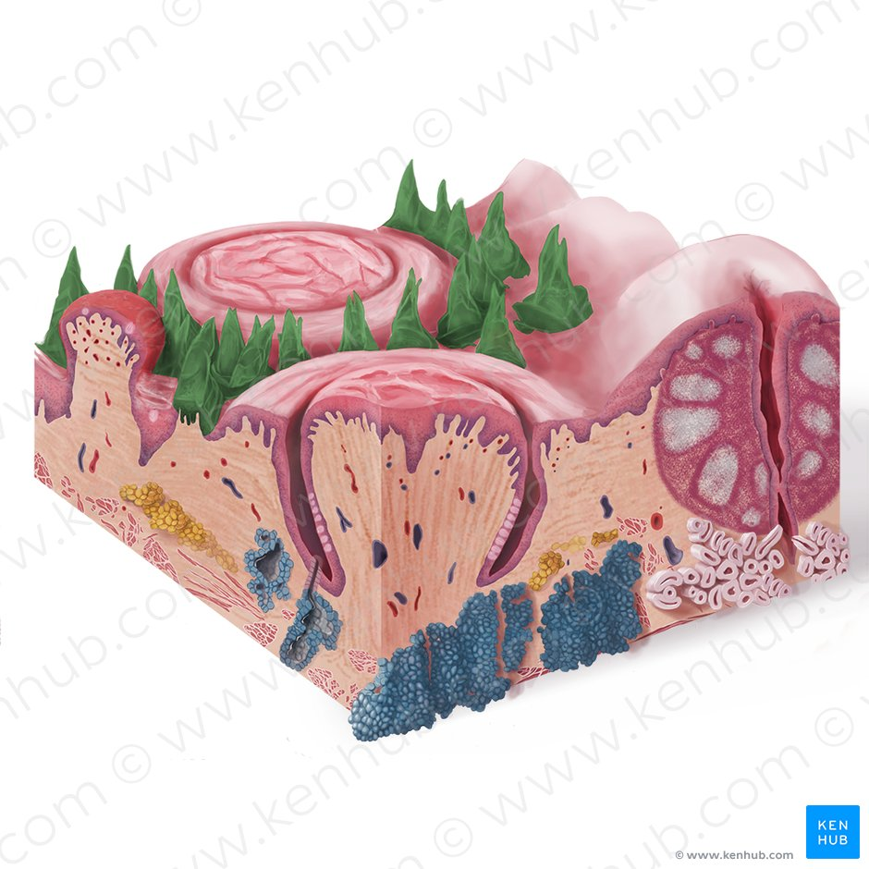
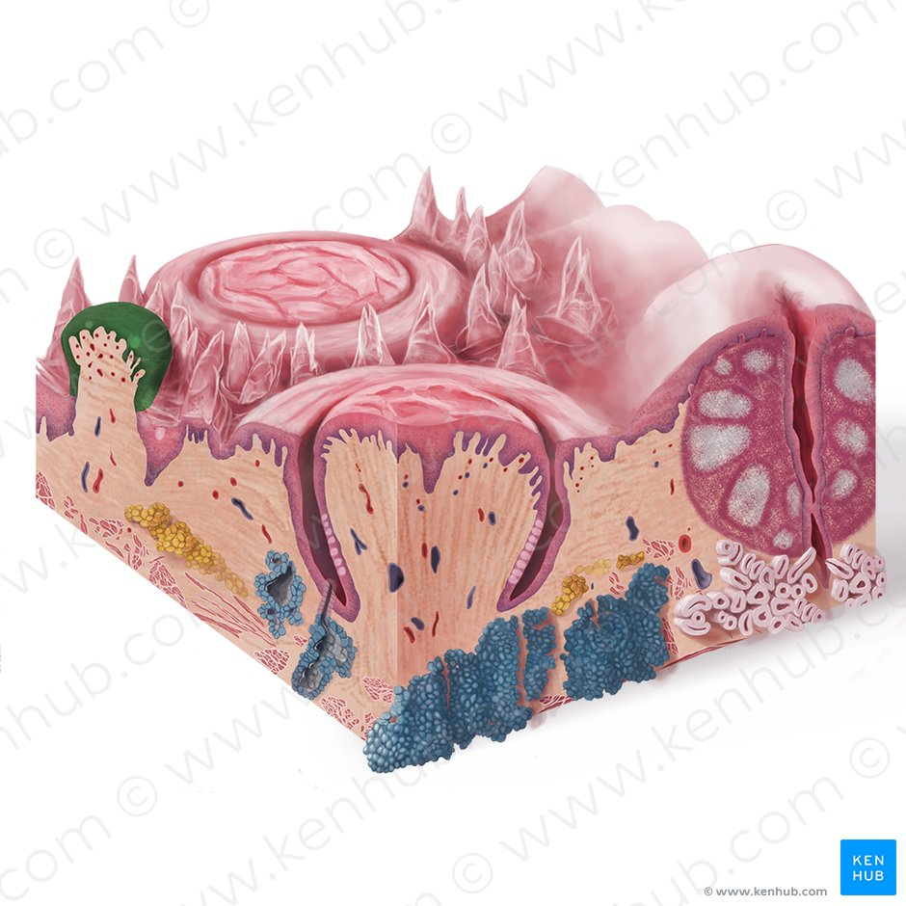
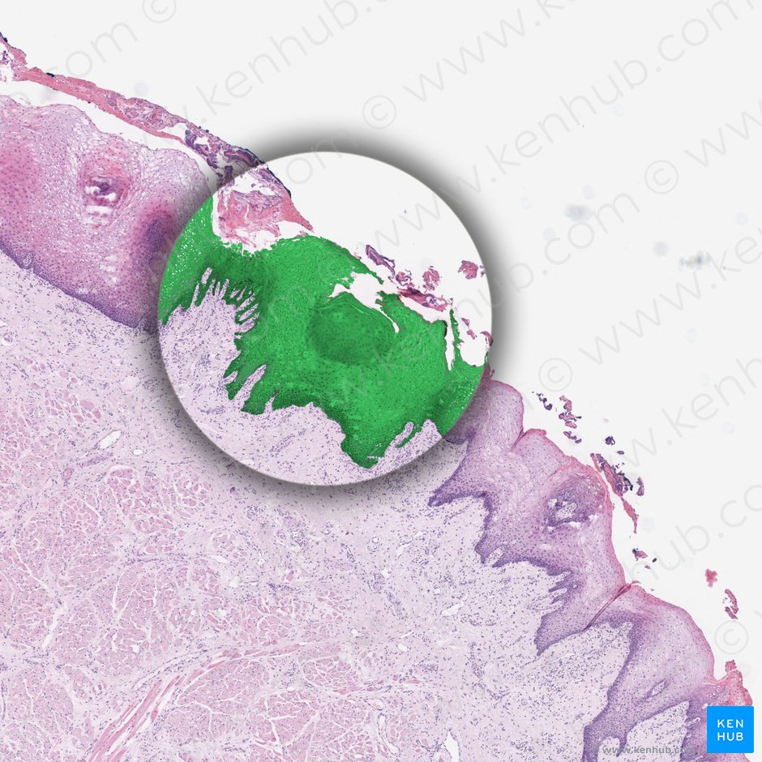
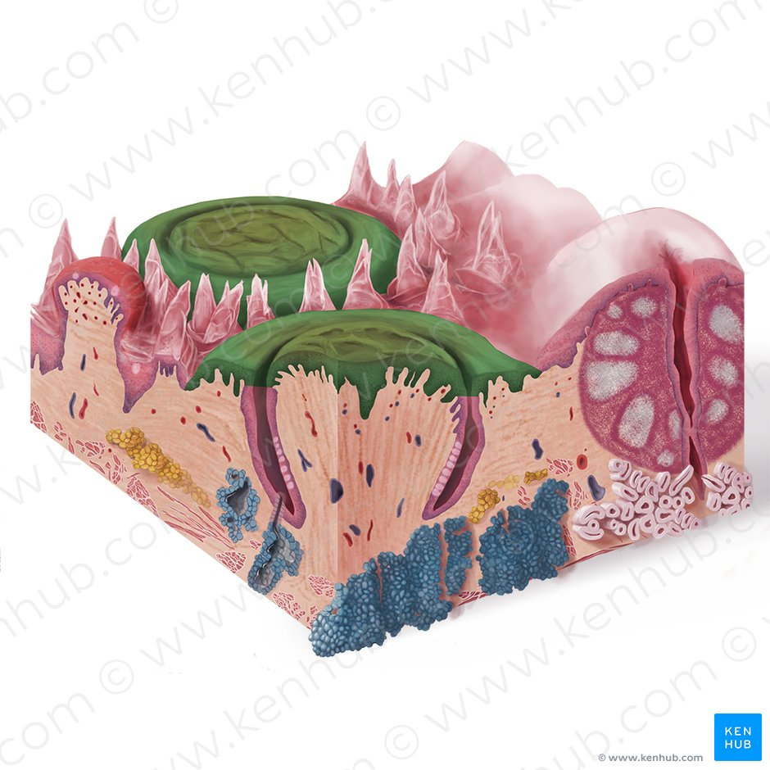

Slide 17
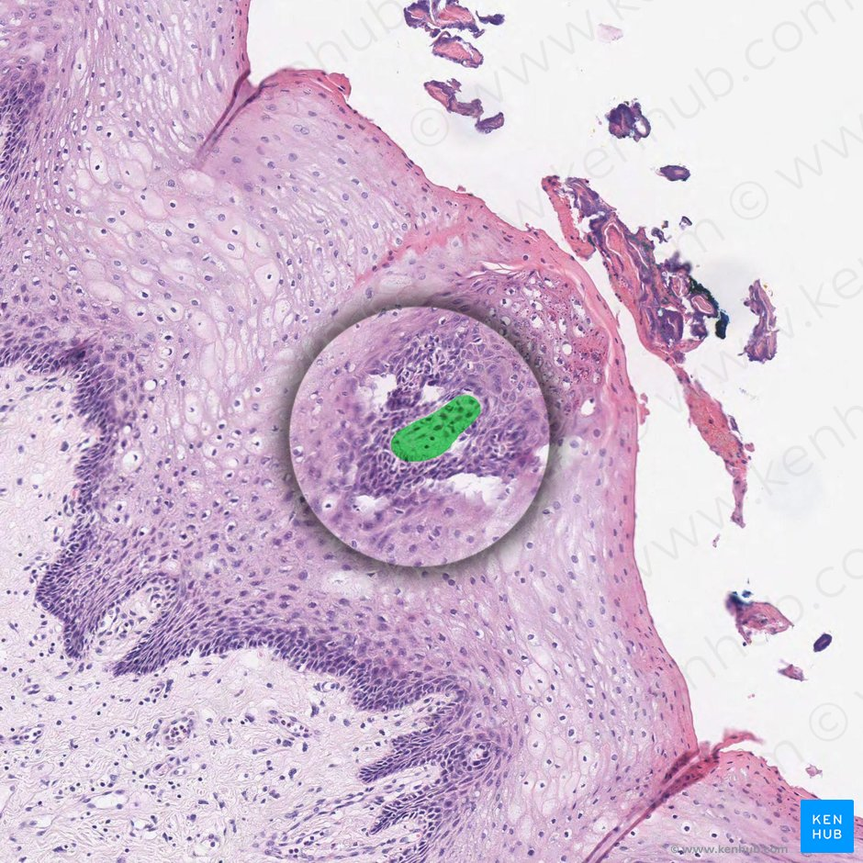
THE TASTE BUDS
The taste buds are at higher concentrations on the tongue. Each taste bud is clear, oval and covered by stratified squamous epithelium. A combination of elongated taste (gustatory), supportive and basal stem cells can be found within each taste bud. The gustatory cells have an apical taste pore surrounded by numerous microvilli that binds dissolved molecules and brings them closer to the receptors responsible for taste. However, these cells have a relatively high turnover rate, as their shelf life is roughly seven to ten days.
There are five gustatory sensations that are perceived by individuals. These are sweet, salty, sour, bitter, and umami. The microvilli found on the apical surface of the taste cells are equipped with various receptors that bind to varying molecules. The reaction generated from this compound-receptor interaction gives rise to varying action potentials that are subsequently perceived as taste. Saltiness is often associated with the cationic component of a compound (i.e. sodium ions), while sourness is related to the acidity (concentration of hydrogen ions) in the compound. Organic compounds such as carbohydrates or amino acids give rise to sweet taste, while bitterness is associated with long-chain organic compounds. The final taste - umami - also known as savory, is related to compounds with the left-handed chiral isomer of glutamic acid.

Slide 18
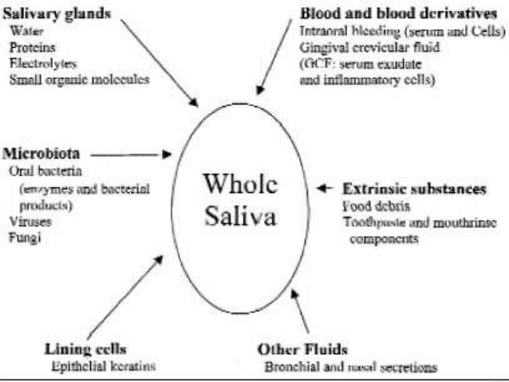
SALIVARY GLANDS
The salivary glands are exocrine glands that are positioned in the head, in and around the oral cavity and secrete their salivary contents into the mouth. Their function is to help keep the oral mucosa protected and lubricated.
They contribute to digestion through the enzymes they excrete with saliva, mainly amylase that starts the digestion of carbohydrates.

Slide 19
The salivary glands are divided into the major and minor salivary glands.
The major glands are much larger in size and are a collection of exocrine tissue that secretes as a whole into a salivary duct rather than acting individually and therefore end up producing a much larger amount of saliva per day than the minor glands.
The main role of the minor glands is to lubricate the walls of the oral cavity, while digestive and protective saliva is produced by the major glands.

Slide 20
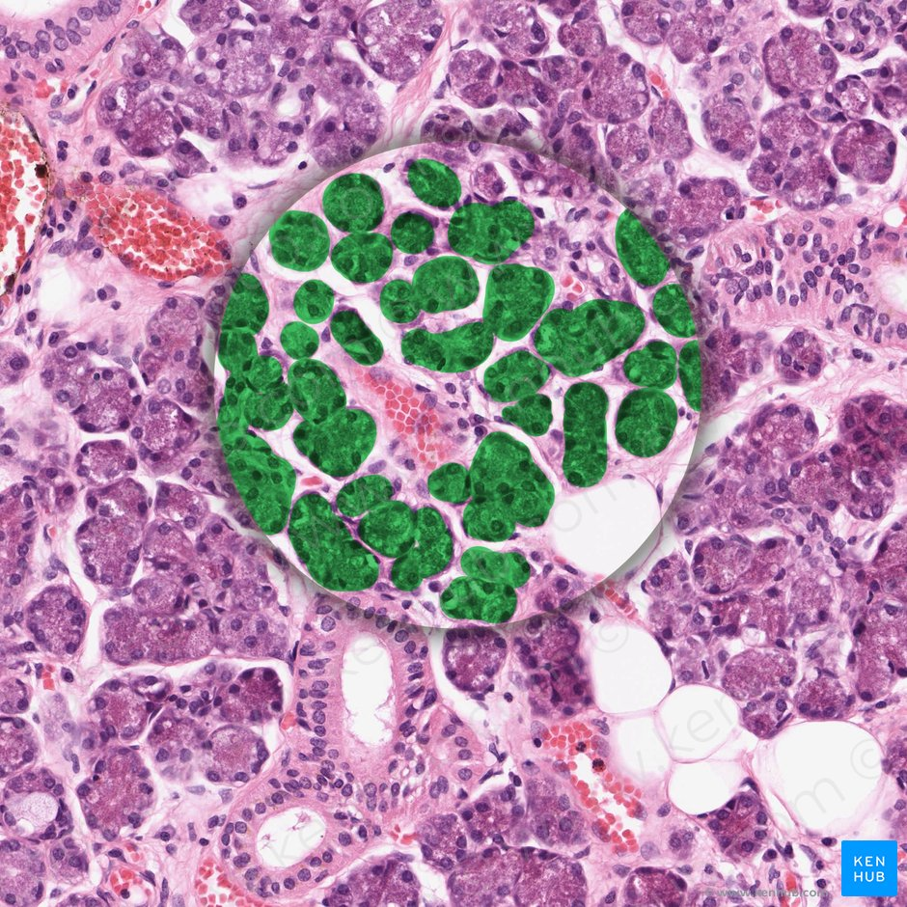
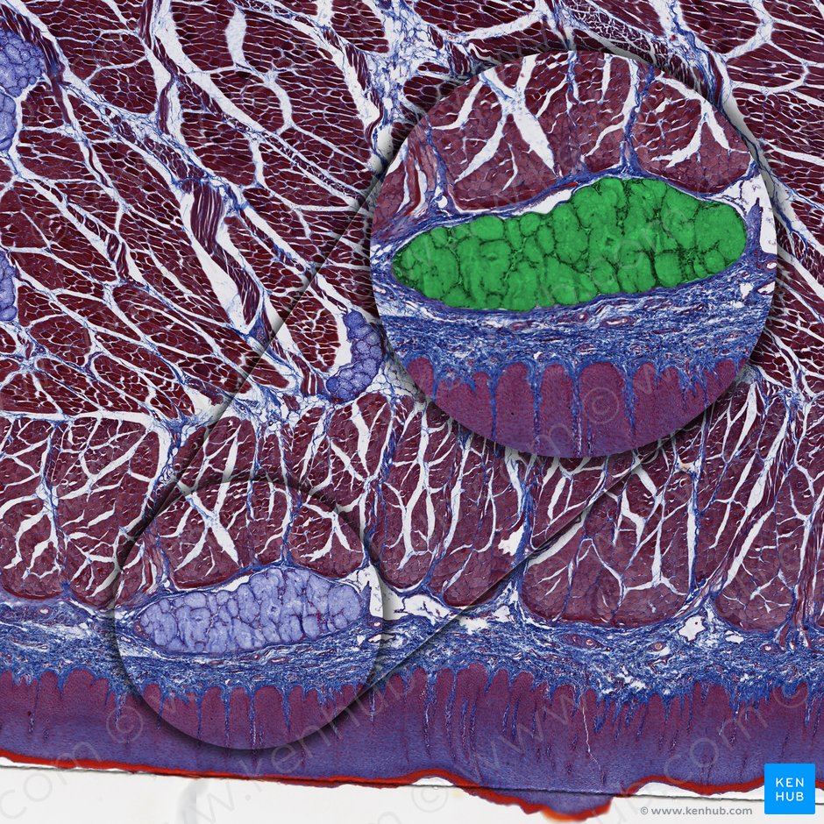
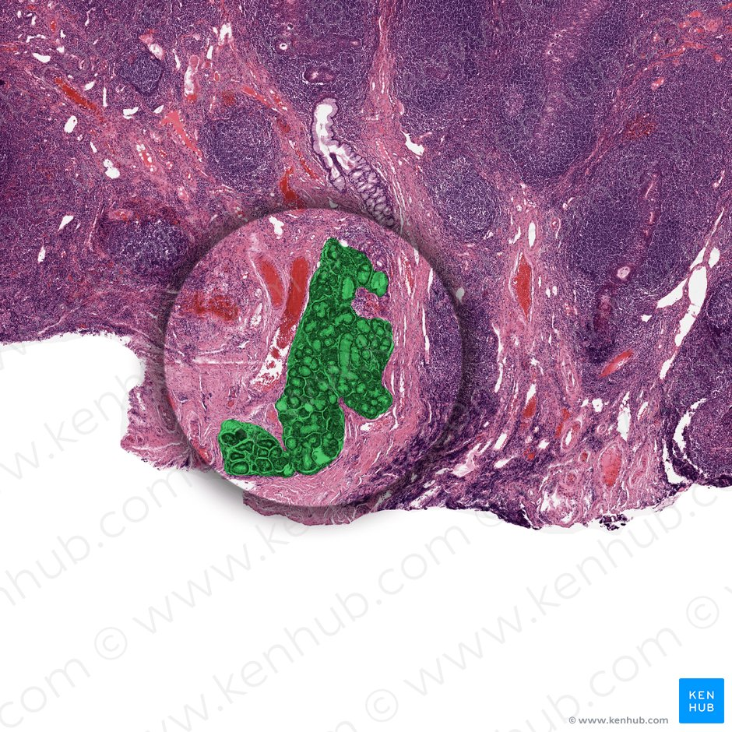
SALIVA
Saliva is a seromucinous liquid that has several major functions within the oral cavity which include lubrication, digestion, antimicrobial action, buffering, hormone regulation and taste sensation. It contains 99.5% water and the rest is electrolytes, mucus, glycoproteins, enzymes and antibacterial compounds.
There are two major types of saliva that are secreted from the salivary glands and they are serous and mucous. The submandibular gland secretes both types in a 3:2 ratio of serous to mucous respectively. The parotid gland is the only gland that secretes purely serous saliva, while the sublingual gland and minor salivary glands secrete mainly mucous saliva.
The total daily output of saliva in an adult is between 1-1.5 liters of saliva.

Slide 21
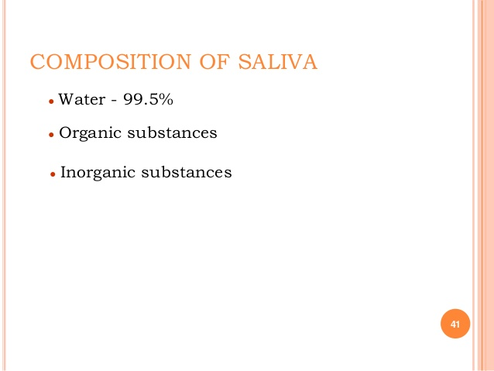
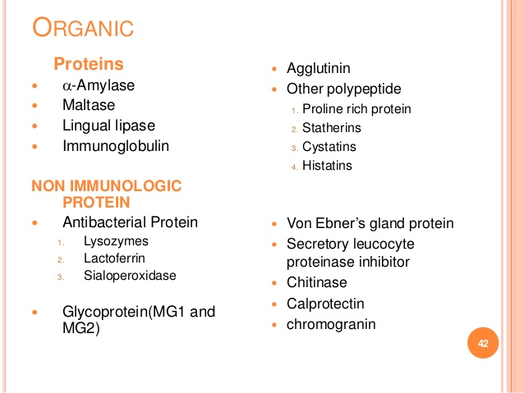

Slide 22
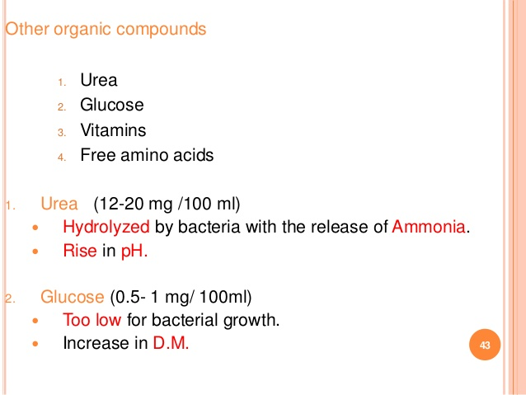
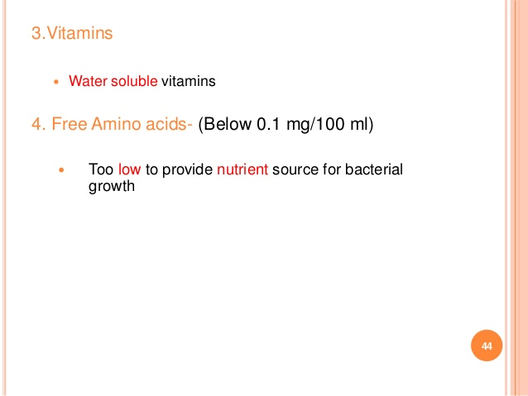

Slide 23
The parotid gland is the largest of the major salivary glands and it sits bilaterally in between the ramus of the mandible and the sternocleidomastoid muscle. It produces between 25-30% of the total daily salivary output which is released through Stensen’s duct (parotid duct) whose orifice can be seen on the buccal wall at the level of the maxillary second molar.
The submandibular gland is the second largest of the major salivary glands and like all three of them it is a paired gland. It produces by far the largest amount of saliva of all and account for up to 70% of the total daily output. Wharton’s duct (submandibular duct) opens at the sublingual papilla under the tongue.
Lastly, the sublingual gland is the smallest of the major salivary glands and is unique in the fact that it has several ductal openings that run along the sublingual folds. It also secretes the smallest portion of saliva per day out of the major glands at just five percent.

Slide 24
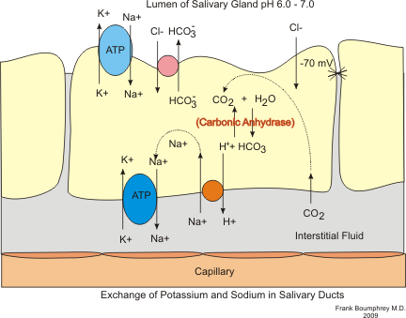
PRODUCTION OF SALIVA
Saliva is produced by the salivary glands of body – the parotid, submandibular and sublingual glands. Within the glands, the acinar cells are responsible for the volume of saliva secreted, and the duct cells are responsible for the composition of saliva.

Slide 25
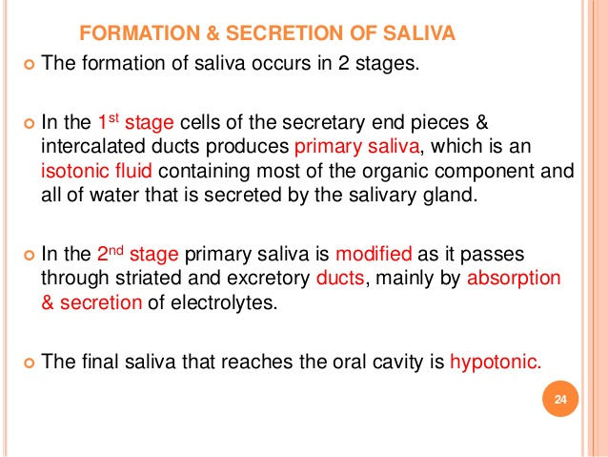
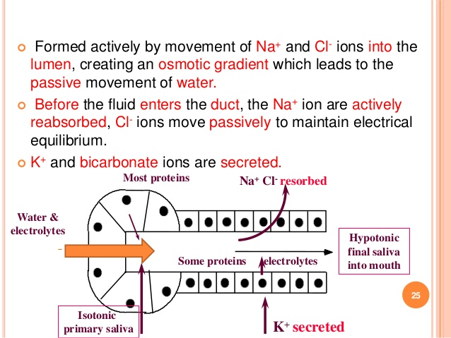

Slide 26
REGULATION OF SALIVARY SECRETION
Autonomic Control
Sympathetic Innervation
The sympathetic control of salivary production is via the superior cervical ganglion. Sympathetic stimulation results in the release of noradrenaline, which acts upon alpha- and beta-adrenergic receptors.
This results in the following effects:
Decreased production of saliva by acinar cells
Increased protein secretion
Decreased blood flow to the glands
There is variable sympathetic innervation between the salivary glands. On the whole, this system is far less important than the parasympathetic innervation in terms of regulating production of saliva.
Parasympathetic Innervation
The parasympathetic outflow is coordinated via centres in the medulla, and innervation occurs via the facial and glossopharyngeal nerves. Afferent information from the mouth, tongue, nose and conditioned reflexes are integrated within the brain – and in the presence of food, parasympathetic stimulation occurs.
Parasympathetic outflow results in the release of acetylcholine (ACh) onto M₃ muscarinic receptors. This results in the following effects:
Acinar cells increase secretion of saliva
Duct cells increase HCO₃– secretion
Co-transmitters result in increased blood flow to the salivary glands
Contraction of myoepithelium to increase the rate of expulsion of saliva
Overall, increased parasympathetic stimulation results in an increased flow of saliva that is more watery in composition.

Slide 27
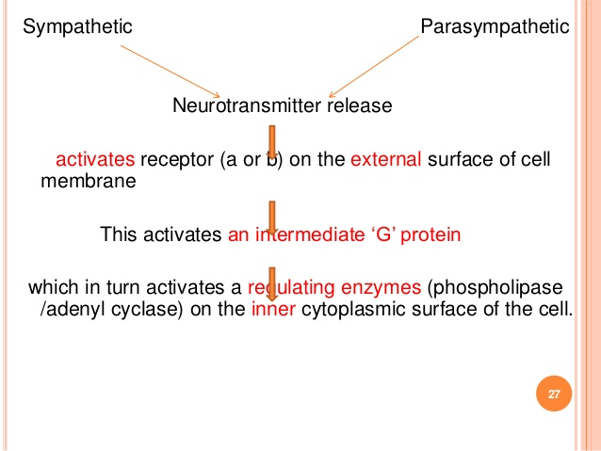
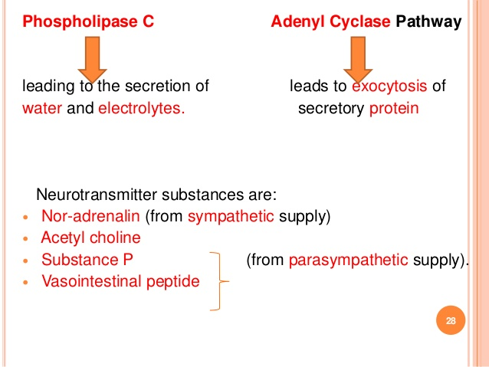

Slide 28
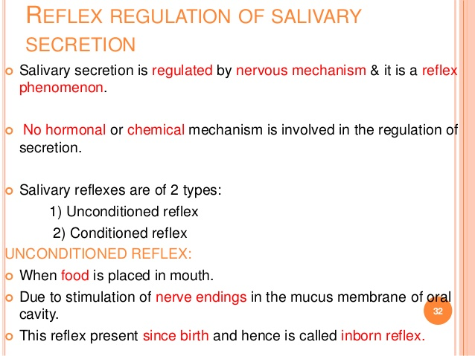
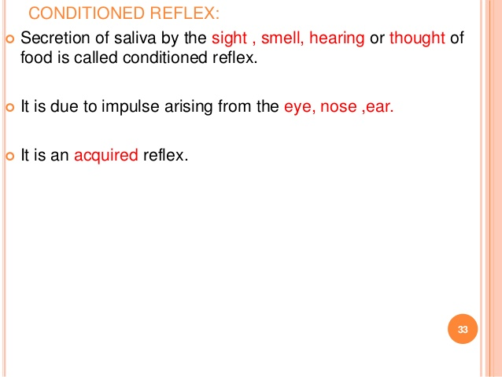

Slide 29
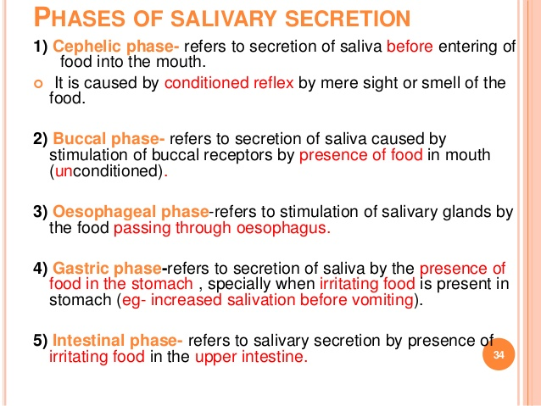

Slide 30
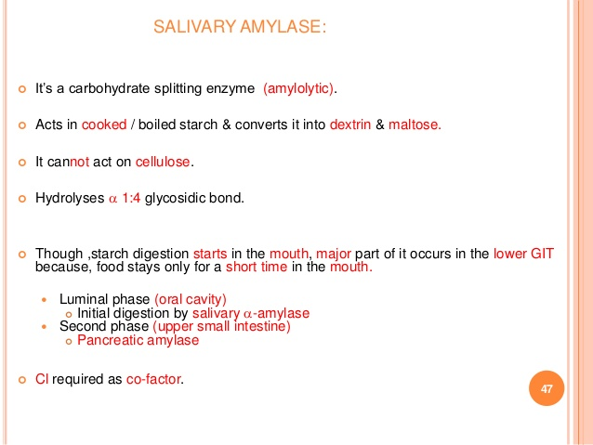
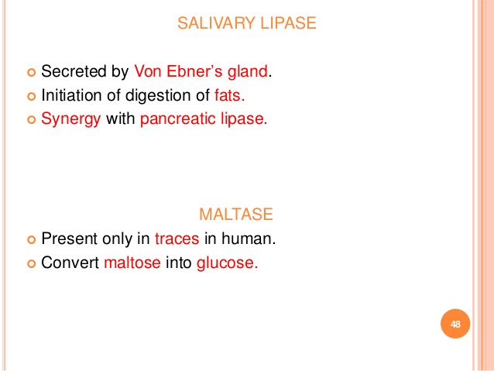

Slide 31
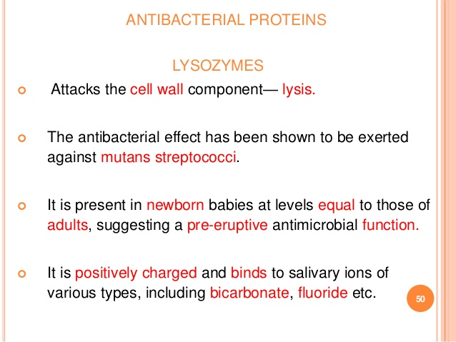
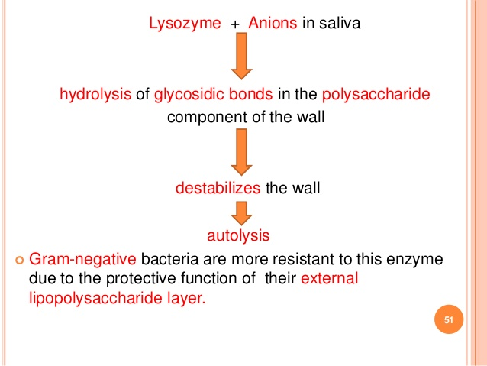

Slide 32
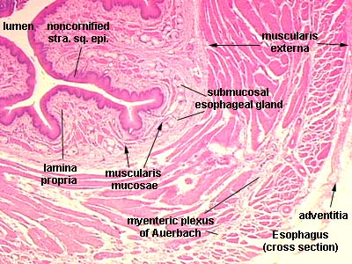
Oesophagus
Mucosa: Stratified squamous non - keratinized epithelium
Submucosa: contains Meissner’s plexus and oesophageal glands
Muscularis externa:
Upper one-third: skeletal fibres
Middle one-third: mixed fibres
Lower one-third: smooth fibres
Adventitia: loose areolar connective tissue

Slide 33
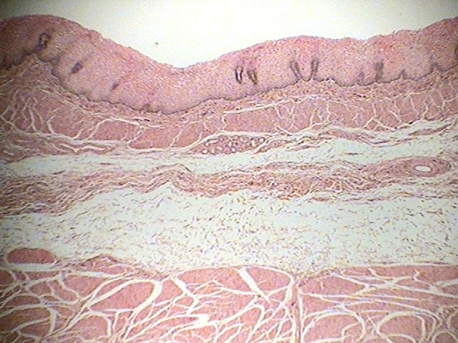
Oesophagus

Slide 34
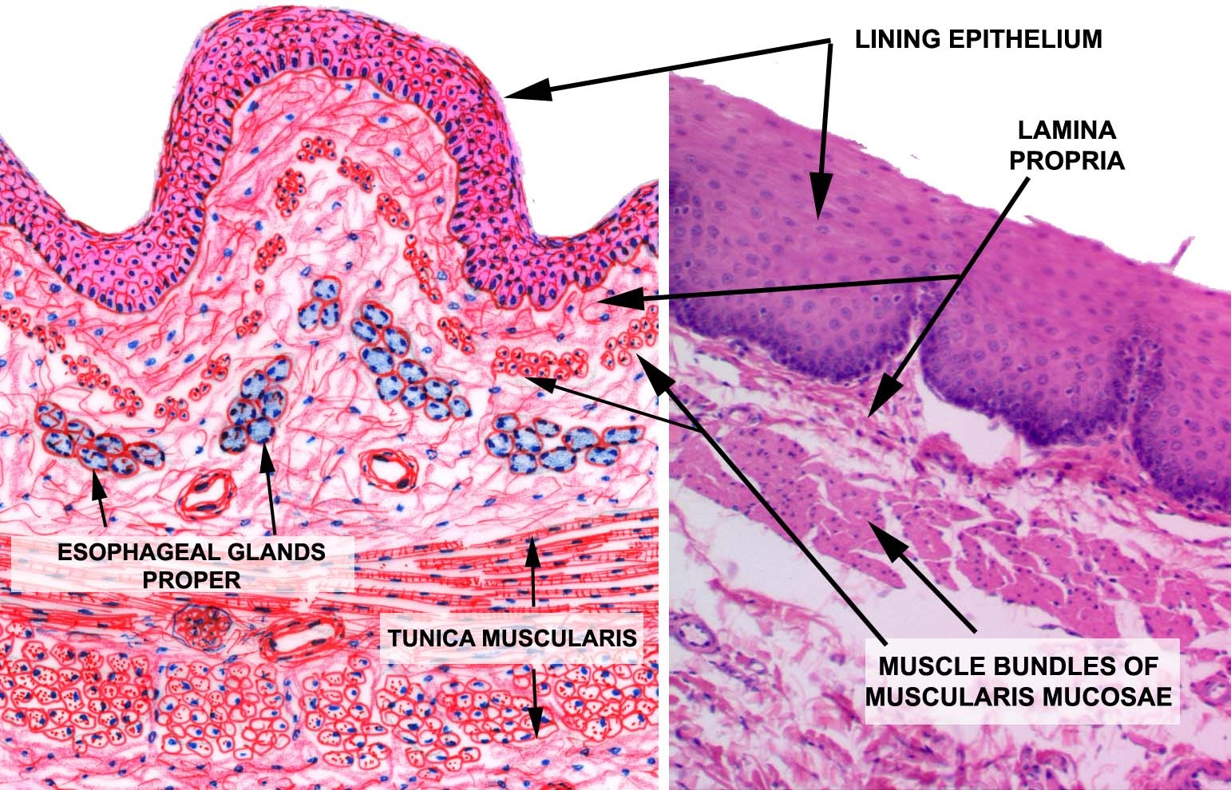
Oesophagus

Slide 35
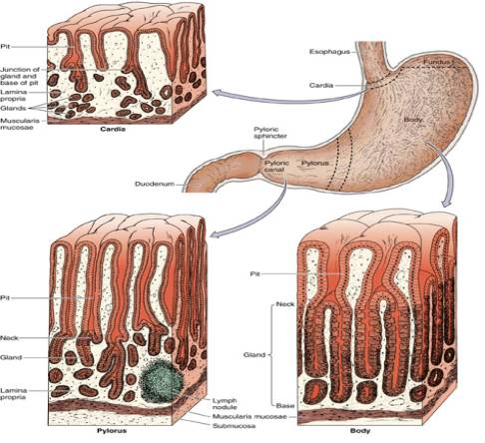
Stomach
it consists of four parts, two curvatures and receives its blood supply mainly from the celiac trunk. Innervation is provided via the vagus nerves and the celiac plexus.
Mucosa:simple columnar epithelium and presence of gastric pits.
Stomach is divided into three histological regions on the basis of nature of glands:
Cardiac region
Fundic region (fundus & body)
Pyloric region

Slide 36
The stomach is located inside the abdominal cavity in a small area called the bed of the stomach, onto which the stomach lies when the body is in a supine position, or lying face up. It spans several regions of the abdomen, including the epigastric, umbilical, left hypochondriac, and left flank regions. The stomach also has some precise anatomical relations and comes in contact with several neighboring structures.
The stomach consists of several important anatomical parts. The four main sections of the stomach are the cardia, fundus, body, and pyloric part. As the name implies, the cardia surrounds the cardiac orifice, which is the opening between the esophagus and the stomach. It is the first section that ingested food passes through, representing the inflow part. The fundus is the superior dilation of the stomach, which is located superiorly relative to the horizontal plane of the cardiac orifice.

Slide 37
Next, we have the corpus, or gastric body, which is the largest part of the organ. Finally, the pyloric part represents the outflow section of the stomach, passing stomach contents into the duodenum. The pylorus is further divided into two distinct areas – the pyloric antrum connected to the stomach and the pyloric canal connected to the duodenum. The contents of the pyloric canal enter into the duodenum via the pyloric orifice, the opening and closing of which are controlled by the pyloric sphincter (pylorus), a circular layer of smooth muscle.
As you might notice in the stomach diagram illustrated above, the organ has a characteristic J-shape created by two unequal curvatures. The longer and convex curvature located on the left of the stomach is called the greater curvature, this starts from the cardiac notch that is formed between the esophageal border and fundus. In contrast, the shorter concave curvature found to the right is the lesser curvature. The latter contains a small notch called the angular incisure which marks the line of intersection between the body and pyloric part of the stomach.

Slide 38
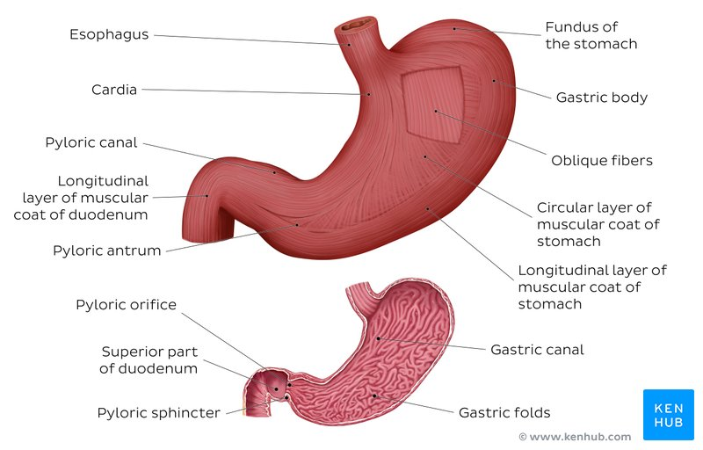

Slide 39
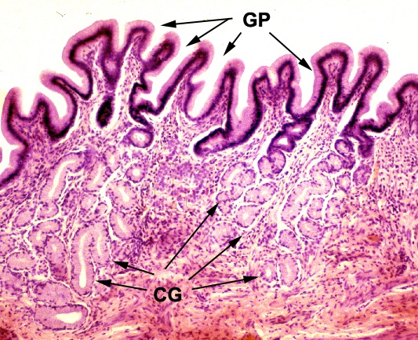
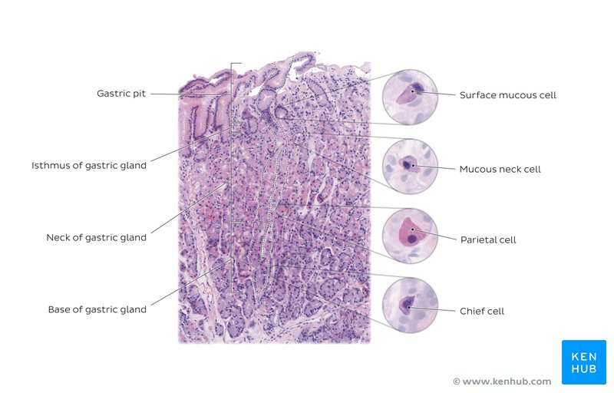
Stomach (cardiac region)
Mucosa: simple columnar with oval nuclei, mucous secreting cardiac glands in lamina propria.
Submucosa: connective tissue.
Muscle layer: inner circular, outer longitudinal.
Serosa: simple squamous epithelium.

Slide 40
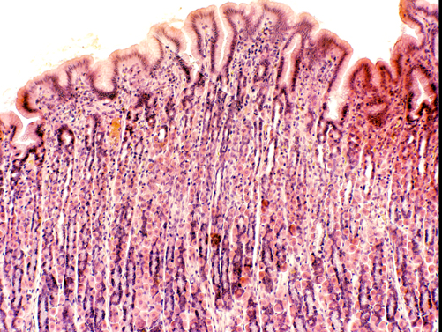
Stomach (Fundic Region)
Mucosa: simple columnar with oval nuclei, presence of gastric glands in lamina propria.

Slide 41
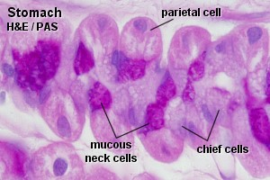
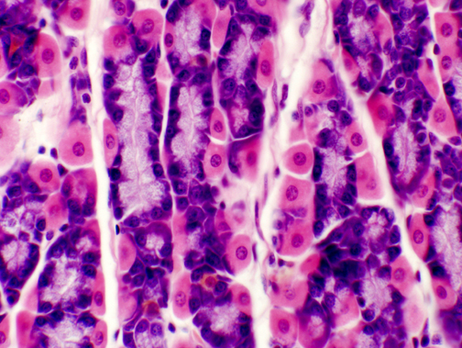
Stomach (Fundic Region)
Cells of fundic region:
Mucous neck cells
Parietal (oxyntic) cells
Chief (peptic/zymogen) cells
Enteroendocrine cells
Undifferentiated cells

Slide 42
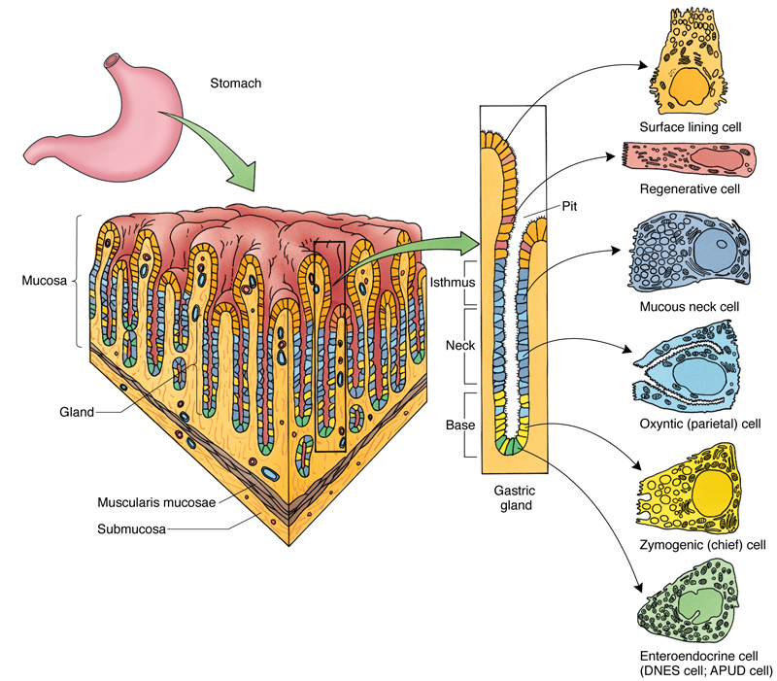
Cells of fundic region

Slide 43
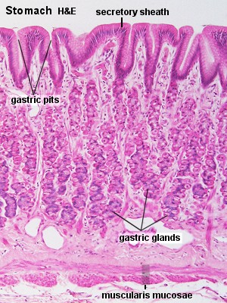
Stomach (Fundic Region)
Submucosa: contains blood vessels, lymphatics and Meissner’s plexus.
Muscularis Externa: an inner oblique (absent in pylorus), middle circular and outer longitudinal layer.
Serosa: consist of surface layer of flattened mesothelial cells resting on a thin layer of loose connective tissue with blood vessels and lymphatics.

Slide 44
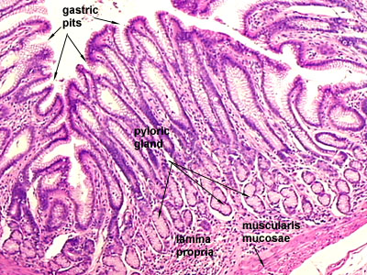
Stomach (Pyloric Region)
Mucosa: pyloric glands in lamina propria & deeper gastric pits extending half the thickness of mucosa.
Muscularis Externa: inner circular (thickened to form pyloric sphincter) and outer longitudinal layer.
Submucosa & Serosa: same as in fundic part.

Slide 45
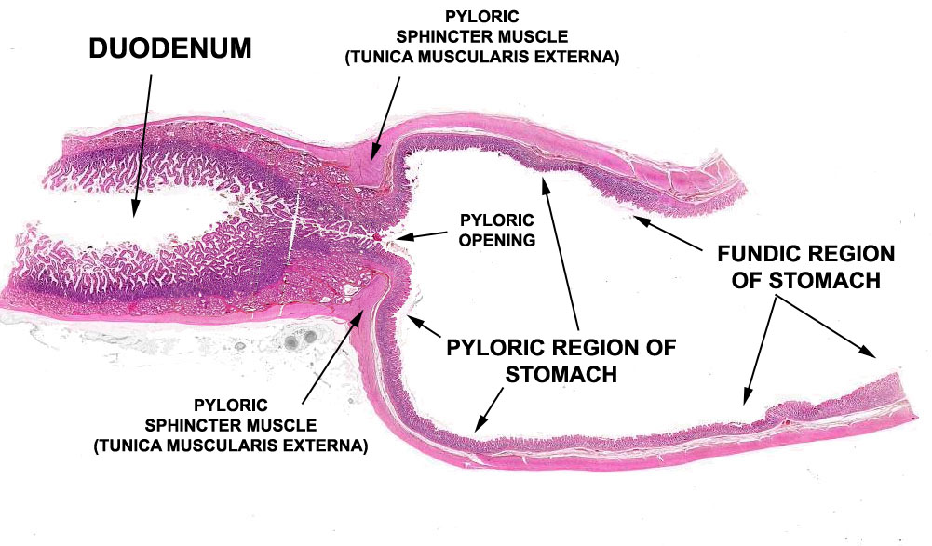
Pyloric Glands

Slide 46


Slide 47


Slide 48


Slide 49


Slide 50


Slide 51


Slide 52


Slide 53


Slide 54


Slide 55


Slide 56


Slide 57


Slide 58


Slide 59


Slide 60


Slide 61


Slide 62


Slide 63


Slide 64


Slide 65


Slide 66


Slide 67


Slide 68


Slide 69


Slide 70


Slide 71


Slide 72


Slide 73


Slide 74


Slide 75


Slide 76


Slide 77


Slide 78


Slide 79


Slide 80


Slide 81


Slide 82


Slide 83


Slide 84


Slide 85


Slide 86


Slide 87


Slide 88


Slide 89


Slide 90


Slide 91


Slide 92


Slide 93


Slide 94


Slide 95


