Slide 1
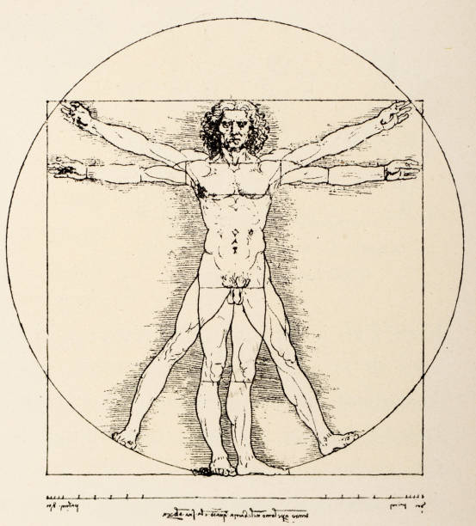
HUMAN ANATOMY

Slide 2
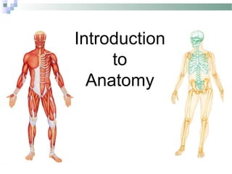

Slide 3
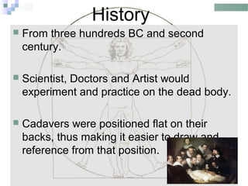

Slide 4
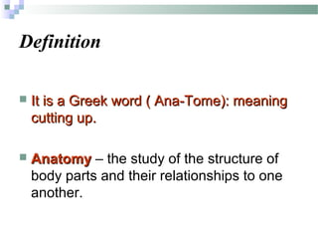

Slide 5
ANATOMY (= to cut open)
GROSS ANATOMY
MICROSCOPIC ANATOMY
DEVELOPMEMTAL ANATOMY
COMPARATIVE ANATOMY
SPECIALIZED BRANCHES OF ANATOMY

Slide 6
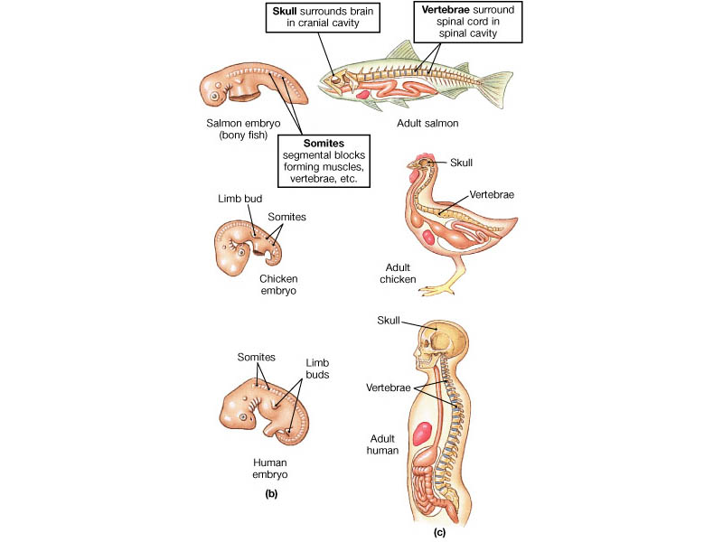
ANATOMY

Slide 7
GROSS ANATOMY
SURFACE ANATOMY (study of internal structures as they relate to the overlying skin)
REGIONAL ANATOMY (superficial and internal features in specific areas of the body )
SYSTEM ANATOMY (11 organ systems)

Slide 8
11 Organ systems different organs work together to provide specialized functions
Body Coverings
Support & Movement
Integration & coordination
Transport
Absorption / Excretion
Reproduction

Slide 9
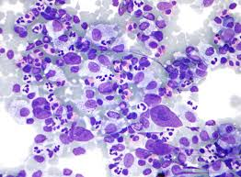
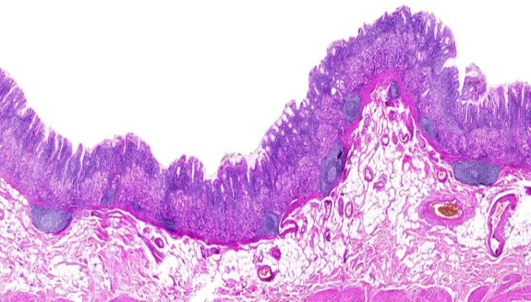
MICROSCOPIC ANATOMY
Cytology (study of the cell - mostly EM pictures)
HISTOLOGY (study of the tissues)

Slide 10
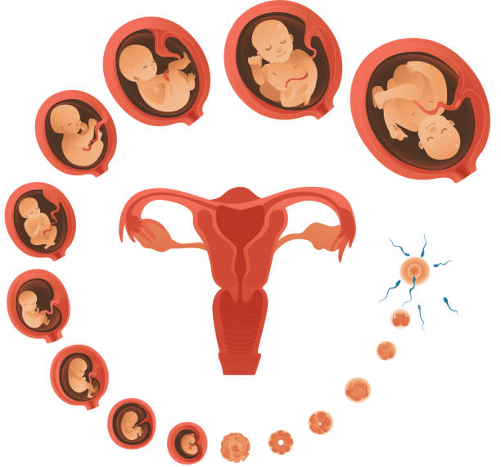
DEVELOPMENTAL ANATOMY
EMBRYOLOGY – study of developmental changes of the body before birth.

Slide 11
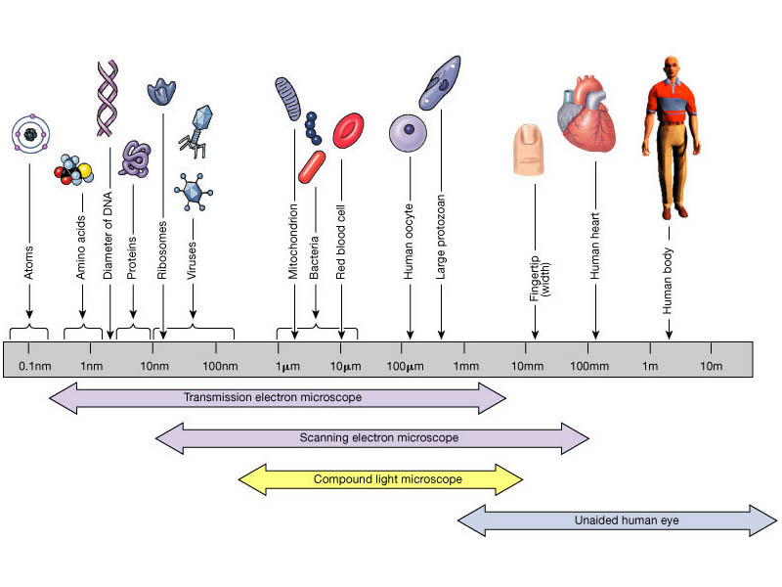
Anatomy at Different Scales (Metric Scale)

Slide 12
SPECIALIZED BRANCHES OF ANATOMY
PATHOLOGICAL ANATOMY –Study of structural changes caused by disease.
RADIOGRAPHIC ANATOMY – Study of internal structure visualized by X-Ray.
MOLECULAR BIOLOGY - Study of anatomical structure at a sub-cellular level.

Slide 13
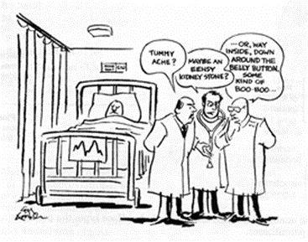
Anatomy & the Importance of a Precise
Vocabulary
Anatomy based
mostly on . . . ?
Also Eponyms (=
?)

Slide 14
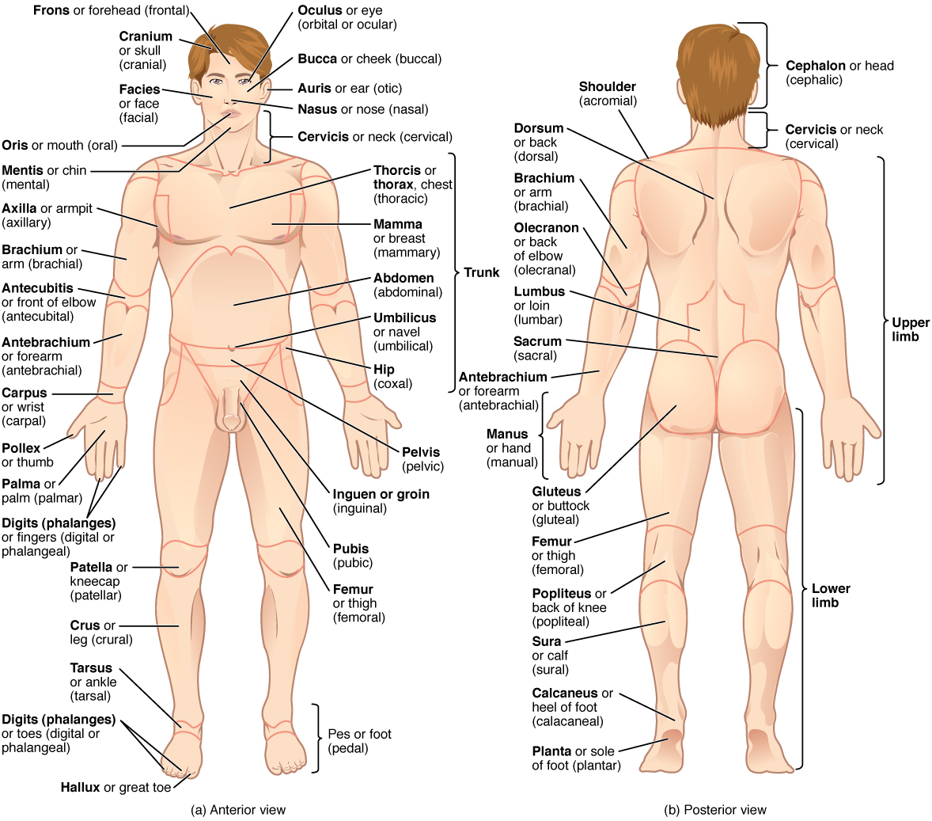
BASIC ANATOMICAL TERMINOLOGY

Slide 15
Superficial Anatomy
Generally consider body in Anatomical Position while studied
Two other positions: supine and prone
Anatomical Directions:
Anterior vs medial vs. superior vs. . . Etc. . . .
Proximal vs. distal

Slide 16
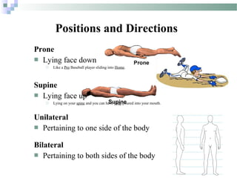

Slide 17
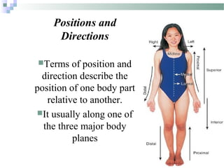

Slide 18
Some Anatomical Directions
Superior and Inferior
Anterior and Posterior
Dorsal and Ventral
Proximal and Distal
Lateral and Medial

Slide 19
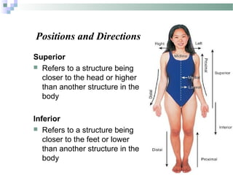

Slide 20
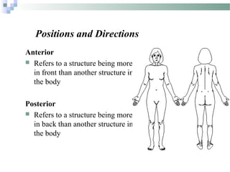

Slide 21
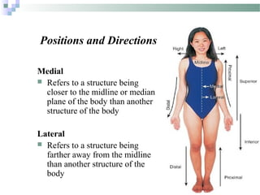

Slide 22
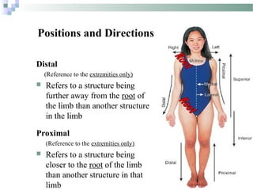

Slide 23
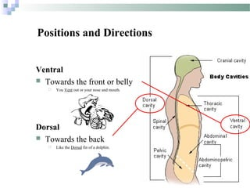

Slide 24
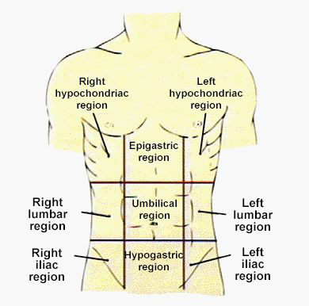
Anatomical Regions

Slide 25
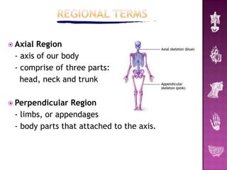

Slide 26
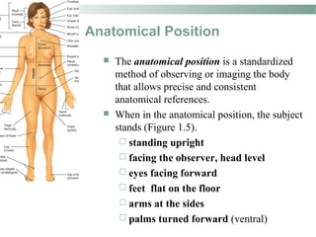

Slide 27
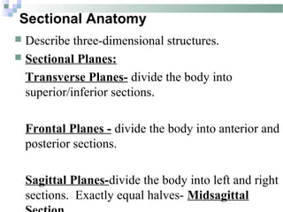

Slide 28
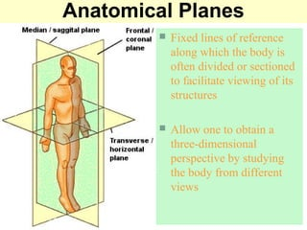

Slide 29
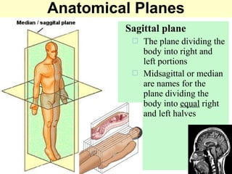

Slide 30
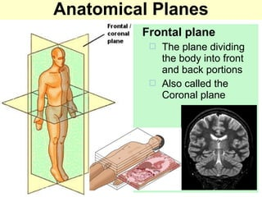

Slide 31
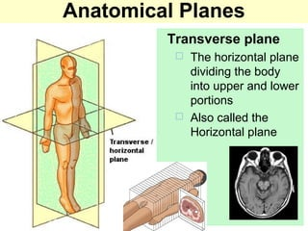

Slide 32
